Slide 1

Building Modern Mobile Apps
Xamarin
Brent Edwards
Principal Lead Consultant
Magenic
Level: Intermediate

Slide 2
Brent Edwards
BrentE@magenic.com
@brentledwards
http://www.brentedwards.net
https://github.com/brentedwards

Slide 3
Mobile Tasks Source Code
Github
https://github.com/brentedwards/MobileTasks

Slide 4
What is Xamarin?

Slide 5
What is Xamarin?
Build Android and iOS Apps with Visual Studio and C#
Xamarin is built on the Mono Framework
Cross-platform implementation of .NET
Comes with
Xamarin Studio (Stand-alone IDE)
Visual Studio plugin
Compiler
Gives access to each platform’s SDK
Allows re-use of C# code libraries

Slide 6
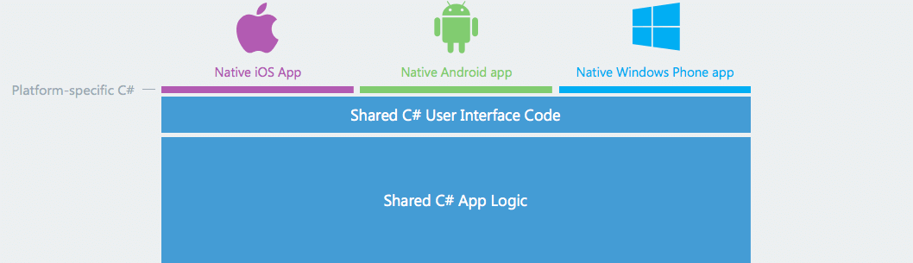
What is Xamarin?
https://www.xamarin.com/platform

Slide 7
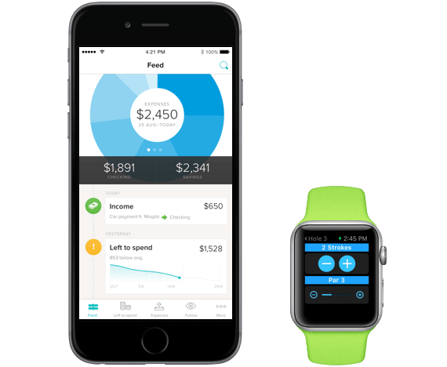
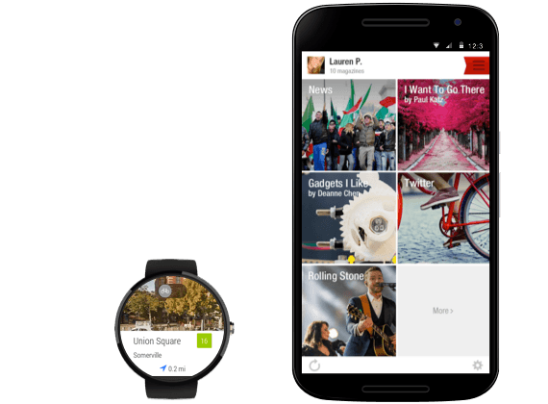
What is Xamarin?
https://www.xamarin.com/platform

Slide 8
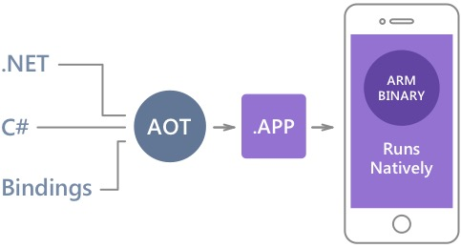
Native Performance
Xamarin.iOS does full Ahead Of Time (AOT) compilation to produce an ARM binary for Apple’s App Store.
Xamarin.Android takes advantage of Just In Time (JIT) compilation on the Android device.

Slide 9
History
Began with Mono
Open source project port of .NET to multiple platforms
Xamarin founded in 2011
Support Mono project
Develop commercial tools leveraging Mono

Slide 10
Dev System requirements

Slide 11
Dev System Requirements
Xamarin.iOS
Mac (Required)
Windows PC (Optional)
XCode
Visual Studio 2012+
Xamarin Plugin
Still has to network with Mac
OS X Yosimite+
Xamarin Studio
Can’t use Xamarin Studio on Windows for iOS

Slide 12
Dev System Requirements
Xamarin.Android
Mac
Xamarin Studio
Windows PC
Visual Studio 2012+
Xamarin Plugin
Windows PC
Xamarin Studio
OS X Yosimite+

Slide 13
Testing
iOS Simulator
On Mac only
Android Emulator
Default Emulator
Genymotion Emulator
Visual Studio Emulator

Slide 14
Device Testing
Test on real devices too!
Emulators/Simulators are only an approximation
Real devices have different constraints and limitations
Test on multiple devices for each target platform

Slide 15
Building Apps

Slide 16
Building Apps
Some Questions
Are you targeting multiple platforms?
Are you hoping to re-use common code/logic?

Slide 17
Re-Using Code/Logic
Know difference between UI-specific code and common logic
UI-specific code interacts with UI elements
Common logic is agnostic of UI

Slide 18
Project Structure
UI-Specific projects for Android and iOS
UI-Agnostic project(s) for common logic
Consider separate solutions if Android and iOS devs are not same people

Slide 19
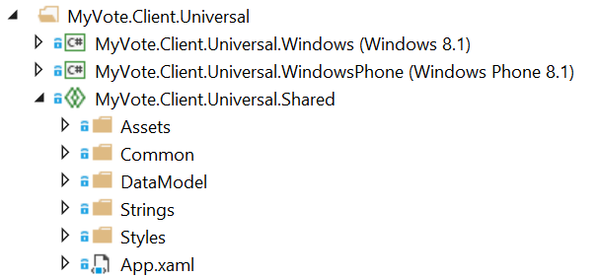
Universal Shared Projects
Essentially a code placeholder project
Does not compile on its own

Slide 20
Universal Shared Projects
Put common code in universal shared project
Platform-specific code in platform-specific projects
What is common?
Models
ViewModels
Converters
Services

Slide 21
What about Portable Class Library?
What is a PCL?
Single project that compiles for multiple platforms
Drawbacks
Lowest common denominator between platforms
Referenced assemblies must be PCL also

Slide 22
Universal Shared Projects
Included with VS 2015
For VS 2013
Shared Project Reference Manager
http://visualstudiogallery.msdn.microsoft.com/315c13a7-2787-4f57-bdf7-adae6ed54450

Slide 23
Project Structure
iOS
UI Code
Controllers
Android
UI Code
Activities
Core Library
Business Logic
Services
Data Access

Slide 24
Xamarin.Android

Slide 25
Xamarin.Android
Primary Components
Android Manifest
Resources
Layouts
Graphic Assets
String Values
Activities

Slide 26
Android Manifest
Defines Activities
We’ll come back to this
Requests Permissions
Examples
Internet access
GPS or network-based location
Camera

Slide 27
Layouts
File that defines the UI
Place views and controls
Assign IDs for Activities to reference
Placed in Resources > layout folder
*.axml

Slide 28
Graphic Assets
Graphic files used by the UI
Placed in Resources > drawable
Can make density-specific folders
Example: Drawable-hdpi

Slide 29
Graphic Assets
Supported Densities
ldpi (~120dpi)
mdpi (~160dpi)
hdpi (~240dpi)
xhdpi (~320dpi)
xxhdpi (~480dpi)
xxxhdpi (~640dpi)

Slide 30
String Values
Define all strings shown in UI
Placed in Resources > values
Strings.xml
Easier for globalization

Slide 31
Activities
Interacts with the user interface
Respond to input
Drives the user experience
Responds to Lifecycle changes

Slide 32
Activities
Implementing an Activity
Decorate with Activity attribute
Signal for Android Manifest
Inherit from Activity class
Override OnCreate method
SetContentView
Wire up UI interactions

Slide 33
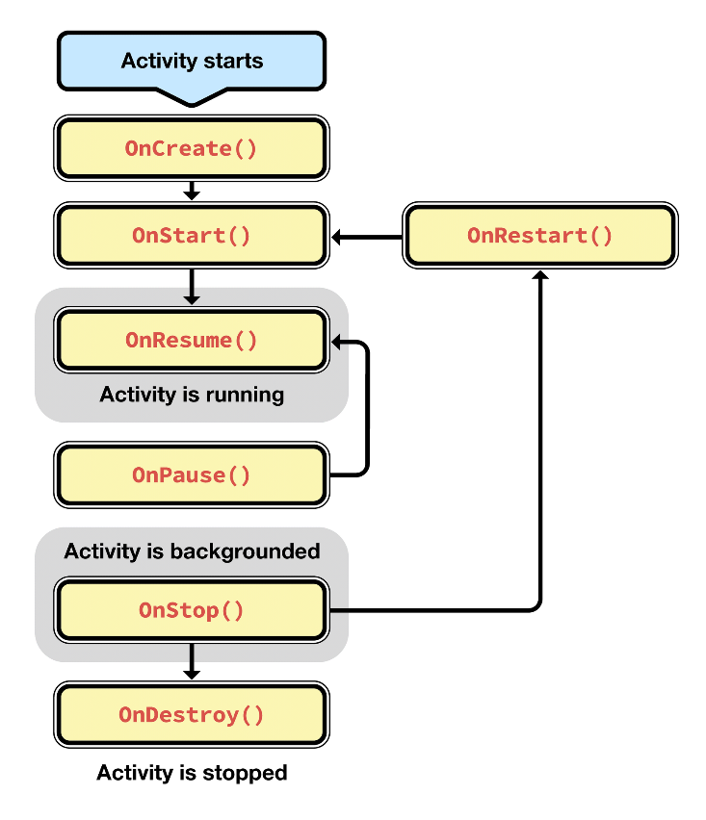
Activity Lifecycle
https://developer.xamarin.com/guides/android/application_fundamentals/activity_lifecycle/

Slide 34
Xamarin.Android
[DEMO]

Slide 35
Xamarin.iOS

Slide 36
Xamarin.iOS
Primary Components
Info.plist
View Controllers
Segues
Storyboards

Slide 37
Info.plist
Defines application properties
Name
Icons
Supported Orientations
Entitlements

Slide 38
View Controllers
Handles interactions between the app and the user
Inherit from UIViewController

Slide 39
Segues
Define transitions between two View Controllers
Examples
Show
Present Modally
Present as Popover

Slide 40
Storyboards
Contain visual designs of the app
Defines Segues from one screen to another

Slide 41
View Controller Lifecycle

Slide 42
Xamarin.ios
[DEMO]

Slide 43
Unit Tests
Create Xamarin.UITest project
Can run tests locally within Visual Studio
Then deploy to Xamarin Test Cloud

Slide 44
Continuous Integration
CI Build Servers can be configured for Xamarin
Install Visual Studio and Xamarin tools
iOS will require a Mac OS X machine for build server
This machine can create final app package

Slide 45
Thoughts on Xamarin

Slide 46
Strengths
Working with Visual Studio and C#
Native look-and-feel
Lots of code re-use

Slide 47
Weaknesses
Mac required (for iOS)
Connection can get flakey
Can’t re-use UI code

Slide 48
Conclusion
Xamarin is a solid choice
As close to native as C# gets
Worth checking out for C# shops

Slide 49
Questions?

